Slide 1
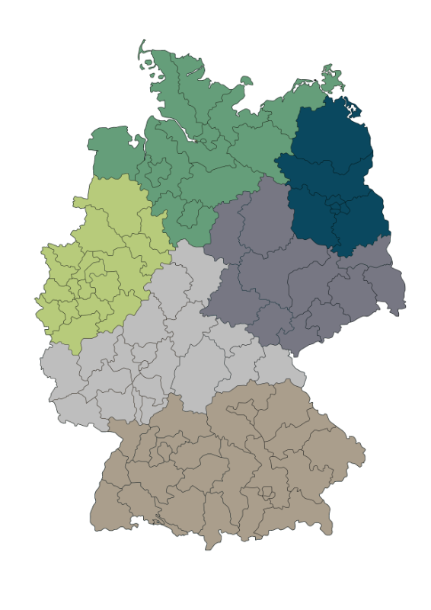
Christian Schmidt
18000 - 31999
Guido Prigge
10000 - 17999
Daniel Terwerth
Benedikt Hoffmann
32000 - 33999
40000 - 53999
57000 - 59999
Matz Rehse
01000 - 09999
38000 - 39999
99000 - 99999
Dennis Zagni
34000 - 37999
54000 - 56999
60000 - 69999
95000 - 98999
Patrick Kaevski
Andreas Ruhdorfer
Simon Klingler
Fabian Bloos
Stefan Blust
70000 - 94999
Sebastian Strohmenger
Key Account Manager, Utilities
Mario Förster
Global Key Account Manager, Residential
Norman Forbert
Key Account Manager, Residential

Slide 2
Christian Schmidt
18000 - 31999
Guido Prigge
10000 - 17999
Daniel Terwerth
Benedikt Hoffmann
32000 - 33999
40000 - 53999
57000 - 59999
Matz Rehse
01000 - 09999
38000 - 39999
99000 - 99999
Dennis Zagni
34000 - 37999
54000 - 56999
60000 - 69999
95000 - 98999
Patrick Kaevski
Andreas Ruhdorfer
Simon Klingler
Fabian Bloos
Stefan Blust
70000 - 94999
Sebastian Strohmenger
Key Account Manager, Utilities
Mario Förster
Global Key Account Manager, Residential
Norman Forbert
Key Account Manager, Residential

